Slide 1




An Interpretable AI Enabled Skin Cancer Detection Model using Convolutional Neural Networks
End-Sem Evaluation
Dr. Rajeev Gupta
Mentor
Krishna Patel
19BCP071
Dhyey Shah
19BCP035

Slide 2


Skin cancer is one of the most common types of cancer globally, with early detection being crucial for effective treatment. In this paper, we propose a skin cancer classification and detection model that leverages deep learning techniques to improve diagnostic accuracy. The proposed model consists of three main stages: image pre-processing, dataset balancing and classification. Then, the images are fed into a deep convolutional neural network (CNN). CNN classifies the images into one of ten categories. To evaluate the performance of the proposed model, we conducted experiments on a dataset of 2455 skin cancer images belonging to 10 classes of which 2357 images were extracted from the Kaggle Dataset while 98 images were acquired from a local dermatologist. The results show that our model achieved an accuracy of 94.5% in classifying skin cancer images, outperforming several state-of-the-art methods. We also compared our model's performance against that of dermatologists, and our model achieved comparable accuracy, demonstrating its potential as an effective tool for skin cancer diagnosis. In conclusion, our proposed skin cancer classification and detection model shows great promise in improving the accuracy and speed of skin cancer diagnosis. By detecting skin cancer at an early stage, our model has the potential to significantly improve patient outcomes and reduce the burden on healthcare systems.

Slide 3
Objective
The objective of this project is to develop a skin cancer detection and classification model that
utilizes convolutional neural network (CNN) models. Specifically, we aim to train a CNN on
a large dataset of skin lesion images to accurately classify skin lesions as either benign or
malignant, with the potential to further classify malignant lesions into different subtypes of
skin cancer. Our model aims to improve the accuracy and speed of skin cancer diagnosis,
potentially leading to earlier detection and improved patient outcomes.
Problem Statement
Skin cancer is one of the most common forms of cancer, and early detection is critical for
successful treatment and patient outcomes. However, visual diagnosis of skin cancer can be
challenging, even for trained medical professionals, due to the wide variety of skin lesions and
the subtleties in appearance between different types of skin cancer. Machine learning,
particularly CNN models, has shown great potential in improving diagnostic accuracy for skin
cancer detection and classification. Therefore, the problem addressed in this project is to
develop a skin cancer detection and classification model using CNN models to improve
diagnostic accuracy and potentially reduce the burden on healthcare systems.

Slide 4
Study Title and Year | Deep Learning Technique | Dataset | Accuracy | Limitations
An enhanced technique of skin cancer classification using deep convolutional neural network with transfer learning models | Deep CNNs with Transfer Learning | ISIC 2018 Skin Lesion | 87.67% | Older Dataset used
Skin cancer classification using Convolutional neural networks | Deep CNNs | ISIC 2017 Skin Lesion | 84.6% | Older Dataset Used and lower accuracy
Multiclass skin cancer classification using Efficient Nets – a first step towards preventing skin cancer | EfficientNets | Dataset with 7 skin cancer types | 91.4% | Only has 7 types of skin lesions
Classification of skin cancer using convolutional neural networks analysis of Raman spectra | Deep CNNs with Raman Spectra Analysis | Raman Spectra Dataset | 97.6% | Limited to skin tissue samples not for all skin cancer types
Skin Lesion Analyser: An Efficient Seven-Way Multi-class Skin Cancer Classification Using MobileNet | MobileNet | Dataset with 7 skin cancer types | 89.63% | Only 7 types of skin lesions and only lightweight transfer learning model used
Our Model | Deep CNN with Data Augmentation | ISIC 2021 dataset with Non skin cancer class | 94.5% | 10 different classes including cancerous and benign skin lesions

Slide 5
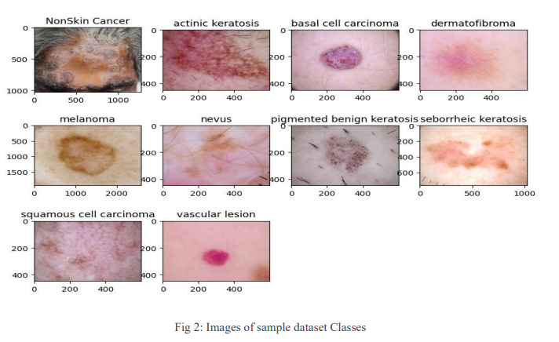

Slide 6


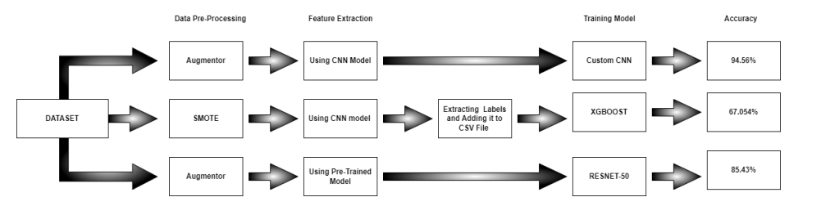
Proposed Methodology

Slide 7
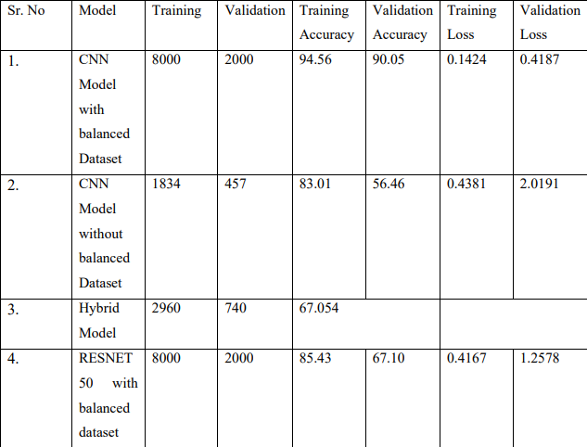
Result

Slide 8
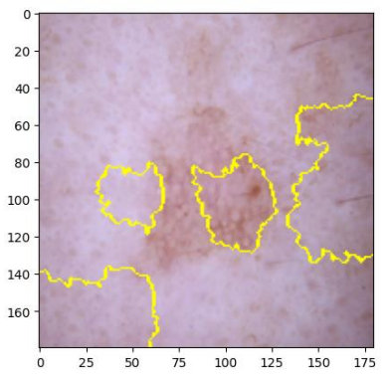
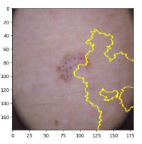
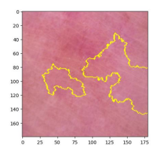
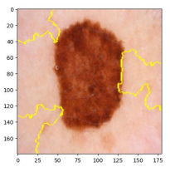
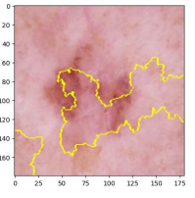
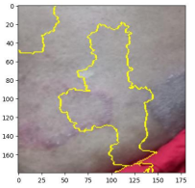
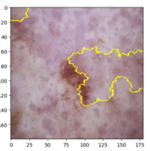
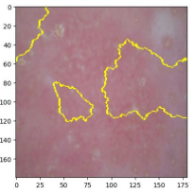
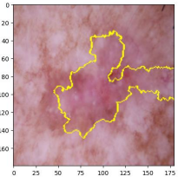
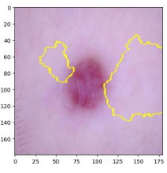
Explanatory Analysis Using LIME
Acitinic Keratosis
Basal Cell Carcinoma
Dermatofibroma
Melanoma
Nevus
Non Skin Cancer
Seborrheic Keratosis
Seborrheic Keratosis
Squamous Carcinoma
Vascular Lesion

Slide 9
Conclusion And Future Work
Overall, the findings of this study show that deep learning approaches have the ability to effectively detect and categorize skin cancer, which can assist in early detection and treatment, eventually improving patient outcomes. The use of explainable AI approaches can give extra insights to medical professionals while also improving the model's predictability. Future research could concentrate on the models' interpretability in order to better understand how they make decisions and provide insights to dermatologists. The use of explainable AI approaches can give clinicians useful information to help them comprehend the decision-making process and get insights into the progression of the illness.

Slide 10




